Slide 1
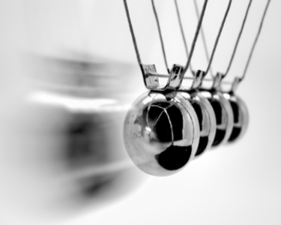
Chapter 5 Momentum

Slide 2
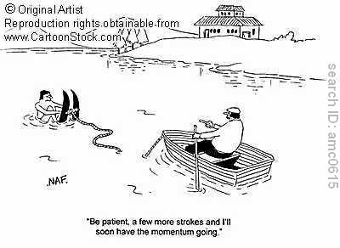
5.1 Momentum is Inertia in Motion
The more momentum something has, the more difficult it is to stop and the larger effect it has in a collision.
Something has to move to have momentum
Momentum = mass x velocity

Slide 3
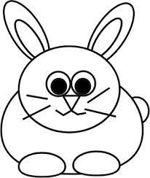
Momentum Example
A 2.5kg rabbit is being chased and moves with a velocity of 10m/s. What is the momentum of the rabbit?

Slide 4
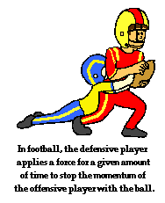
5.2 Impulse Changes Momentum
When momentum changes either:
Mass changes
Velocity changes
Both change
Time is also important though: If you exert the same force over a longer period of time there is a greater change in momentum.

Slide 5
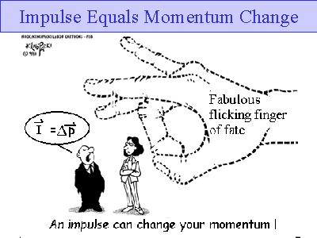
Impulse-Momentum Relationship
The force multiplied by the time during which it acts is equal to the change in momentum.
The more impulse, the more momentum

Slide 6
Example Equation

Slide 7
5.3 Increasing Momentum – Increase Force, Time or Both
To maximize an increase in momentum, apply the greatest force you can and extend the time as much as possible
Practical application: In a collision you want to extend contact time during which your momentum is brought to zero

Slide 8
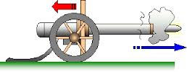
5.5 Momentum is Conserved When no External Force Acts
When no external force is applied, there is no change of momentum.
Law of conservation of momentum!!!

Slide 9
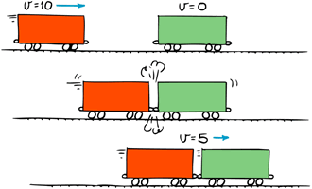
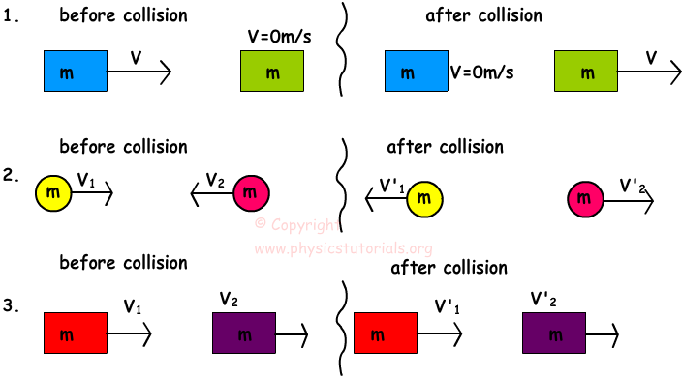
5.6 Momentum is Conserved in Collisions
In any collision we can say that the momentum before is equal to the momentum after the collision.
Two types of collisions:
Elastic
inelastic

Slide 10
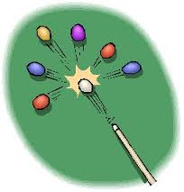
Practice
A 1.50 kg ball moving at 8.00 m/s south, strikes a 2.00 kg ball moving at 3.00 m/s south. If the velocity of the 2.00 kg ball after the collision is 4.50 m/s south, what is the velocity of the 1.50 kg ball?

Slide 11
Vocabulary
Elastic collision
Impulse
Impulse momentum relationship
Inelastic collision
Law of conservation of momentum
momentum

