Slide 1
Chapter 3

Slide 2
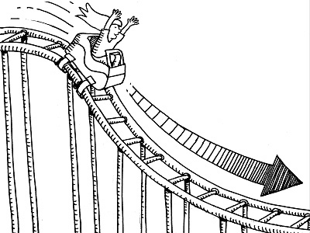
3.1 What is acceleration?
Galileo defined acceleration as the rate of change of velocity.
Formula!
a = Δv / t
Things that affect acceleration:
Speeding up
Slowing down
Changing direction
Time

Slide 3
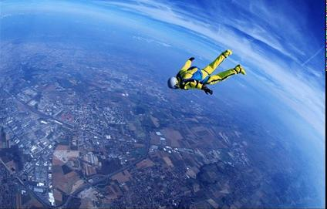
Free Fall
When air resistance does not affect the motion of an object, then the object is in free fall.
Acceleration is the same for ALL objects in free fall.
9.8m/s/s

Slide 4
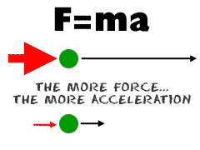
3.2 Force Causes Acceleration
We know that many times there is more than one force acting on an object.
Acceleration is directly proportional to the net force.
Acceleration ~ net force
Example: You pull a wagon with a net force of 20N. You now double the force to 40N. How much will the acceleration increase by?

Slide 5
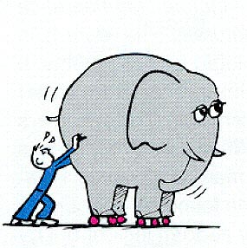
3.3 Mass is a Measure of Inertia
The greater an object’s mass, the greater it’s inertia.
Example: tractor trailers need powerful breaks to stop because they pull such heavy loads and have lots of intertia

Slide 6
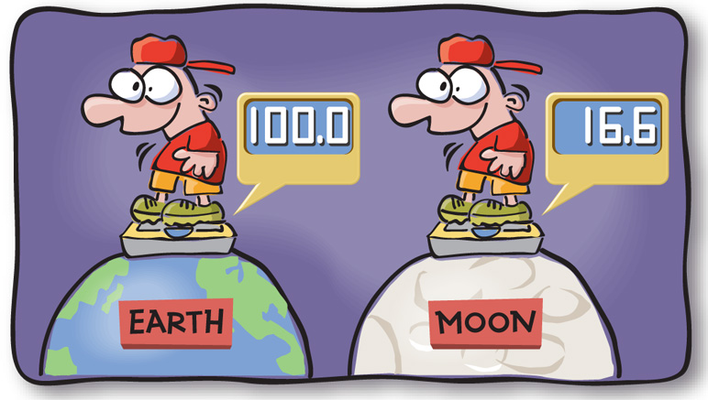
Mass vs. Matter vs. Volume vs. Weight
Mass is the measure of how much matter an object contains
Matter is what the object is made of
Volume is a measure of space
Weight is the force due to gravity that acts of an object’s mass

Slide 7
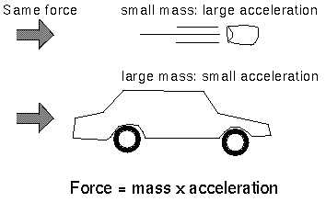
3.4 Mass and Acceleration are Related
More massive objects are more difficult to accelerate
More mass means less acceleration
Acceleration ~ 1 / mass

Slide 8
3.5 Newton’s Second Law
The acceleration produced by a net force on an object is directly proportional to the net force, is in the same direction as the net force and is inversely proportional to the mass of the object.
Acceleration ~ net force / mass

Slide 9
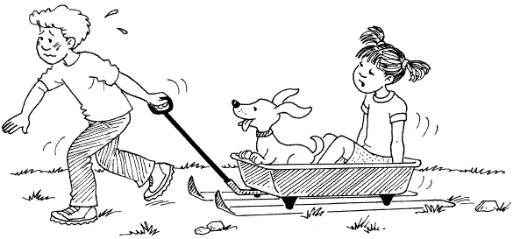
3.6 Friction
Friction is a force that arises when an object rubs against something else
Microwelds
Depends on
Kinds of materials
How much they are pressed together

Slide 10
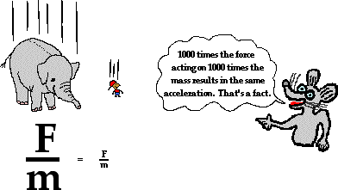
3.7&8 Objects in Free Fall Accelerate at the Same Rate
Acceleration does not depend on mass for objects rolling down inclines.
All freely falling objects have the same force/mass ration and undergo the same acceleration at the same location.

Slide 11
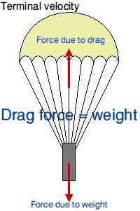
3.9 Air Drag
Air drag is a factor that has to be dealt with for falling objects
It depends on speed and surface area
Skydivers:
Air drag reduces net force and less net force means less acceleration
Skydivers reach a point where they no longer accelerate – terminal velocity

Slide 12
VOCABULARY
Acceleration
Air drag
Free fall
Friction
Mass
Newton’s 2nd Law
Terminal velocity
Volume
weight

