Slide 1
Creating a Graph in Excel Review

Slide 2
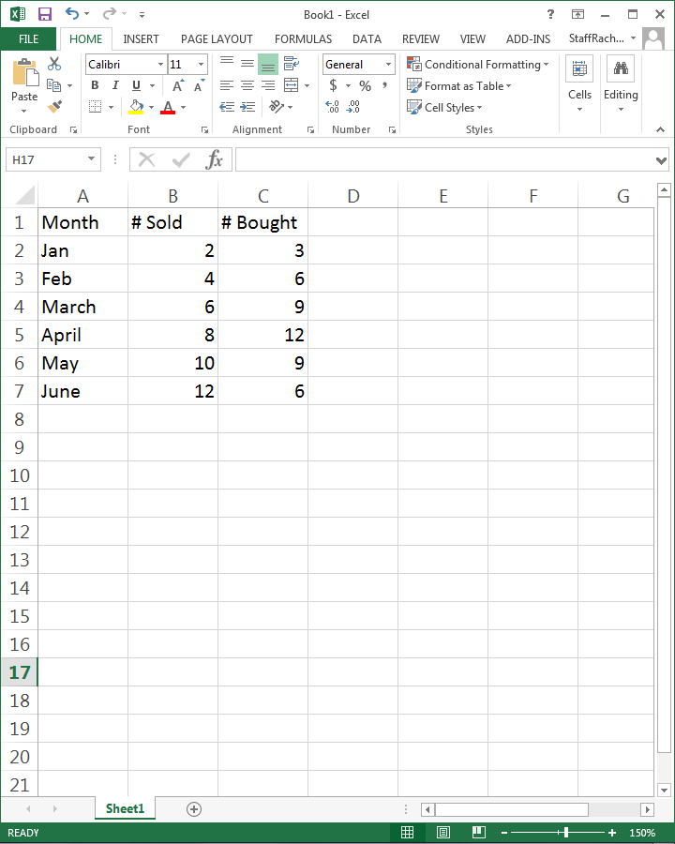
Put the titles of your data in the first row.
Fill in your data underneath.

Slide 3
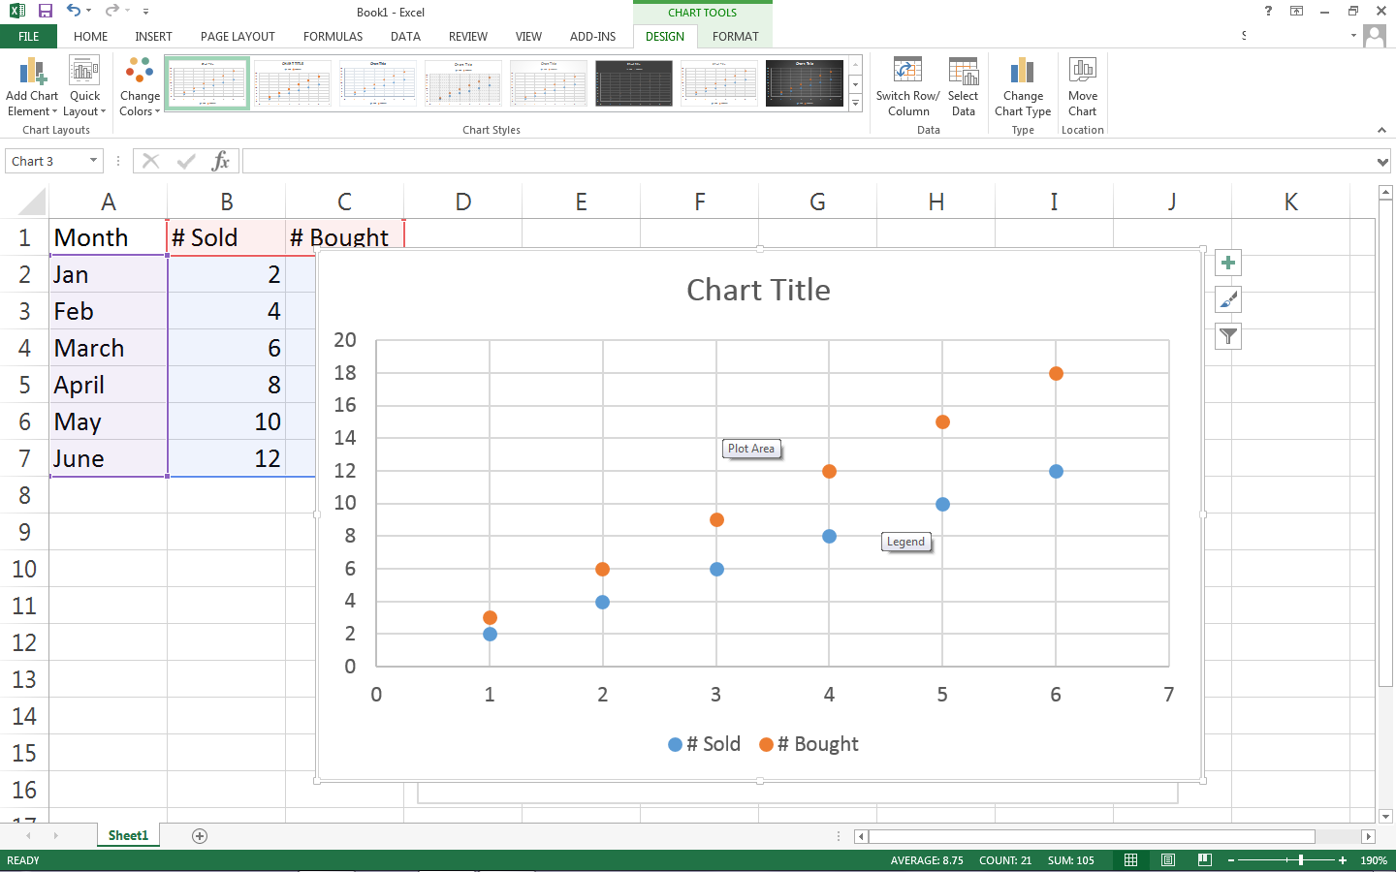
Highlight the data with the headings.

Slide 4
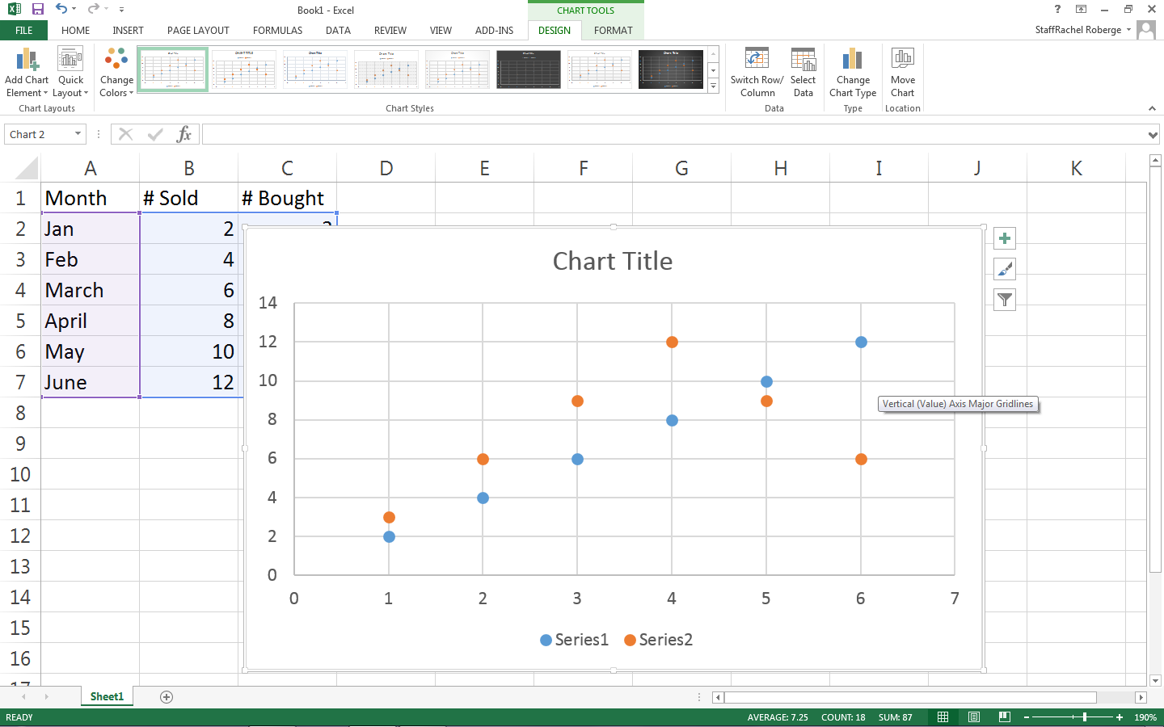
Click on the insert button in the tool bar.
Click on charts and choose XY scatter.
Your chart will appear on the screen.

Slide 5
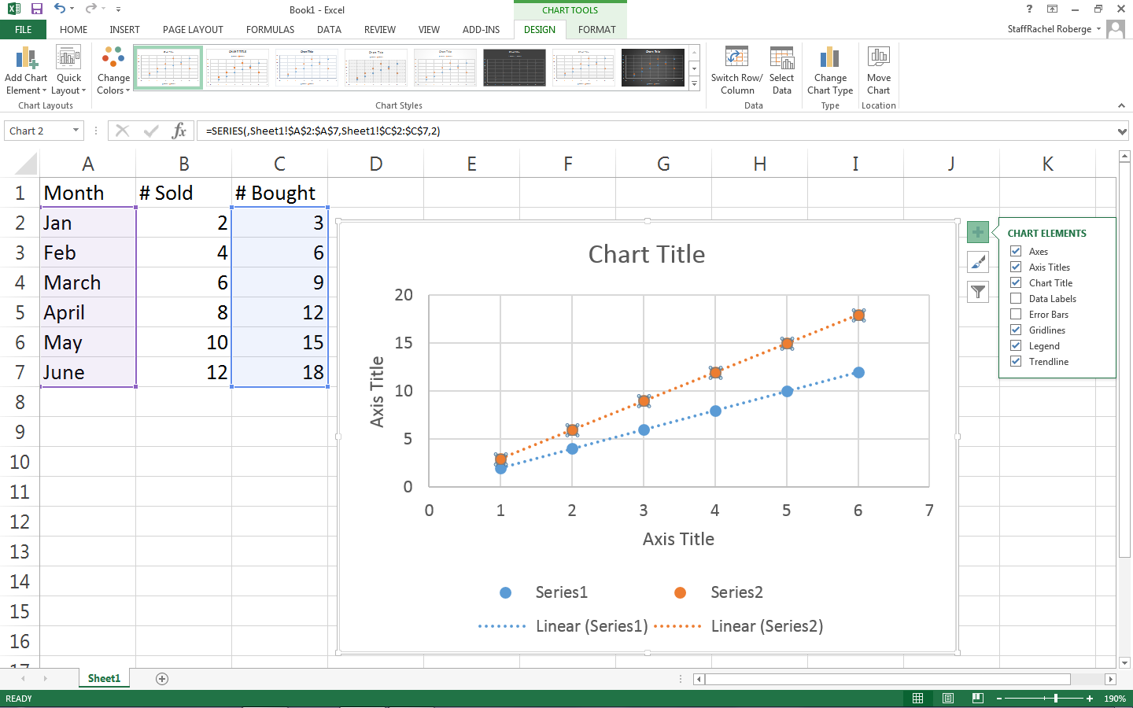
Click on the + sign to the right of the chart. Make sure that the following are checked off:
Axes
Axes titles
Chart title
Gridlines
Legend (if applicable)
trendline

Slide 6
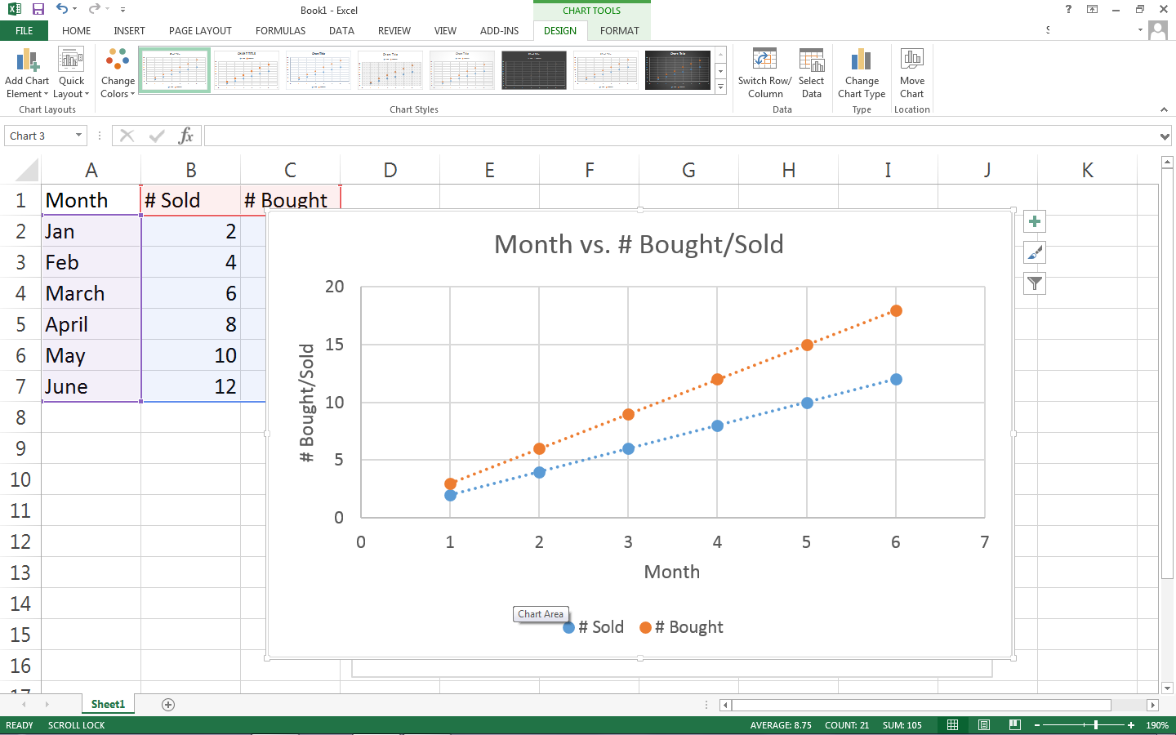
Fill in the axes titles and chart title and if needed the legend.

Slide 7
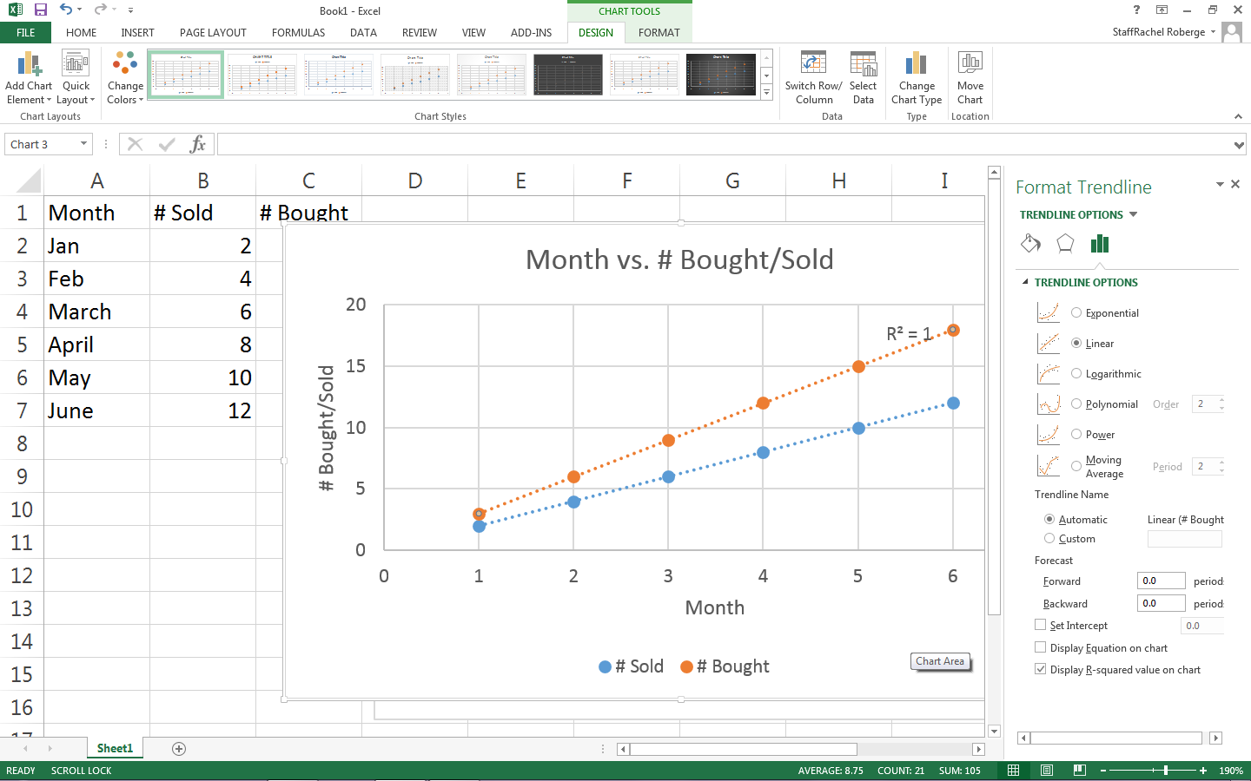
Double click on each line on your chart. A “format trendline” box should appear.
Click on the following:
Display equation
Display R² value

Slide 8
Your excel chart is now complete.
Copy and paste into a word document/lab report, etc as directed and complete your assignment.

