Slide 2
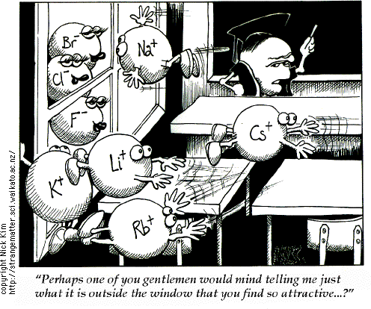
Alkali Metals
Elements in Group 1 are called alkali metals.
lithium, sodium, potassium, rubidium, cesium, and francium
• Alkali metals are so named because they are metals that react with water to make alkaline solutions.
• Because the alkali metals have a single valence electron, they are very reactive.
In losing its one valence electron, potassium achieves a stable electron configuration.
• Alkali metals are never found in nature as pure elements but are found as compounds.
http://www.youtube.com/watch?v=m55kgyApYrY

Slide 3
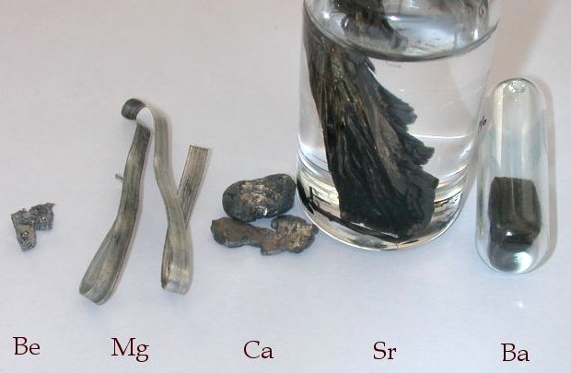
Alkaline Earth Metals
Group 2 elements are called alkaline-earth metals.
• The alkaline-earth metals are slightly less reactive than the alkali metals.
They are usually found as compounds.
• The alkaline-earth metals have two valence electrons and must lose both their valence electrons to get to a stable electron configuration.
It takes more energy to lose two electrons than it takes to lose just the one electron that the alkali metals must give up to become stable.

Slide 4
Transition Metals
The transition metals constitute Groups 3 through 12 and are sometimes called the d-block elements because of their position in the periodic table.
A transition metal is one of the metals that can use the inner shell before using the outer shell to bond.
• A transition metal may lose one, two, or even three valence electrons depending on the element with which it reacts.
• Generally, the transition metals are less reactive than the alkali metals and the alkaline-earth metals are.
Some transition metals are so unreactive that they seldom form compounds with other elements.

Slide 5
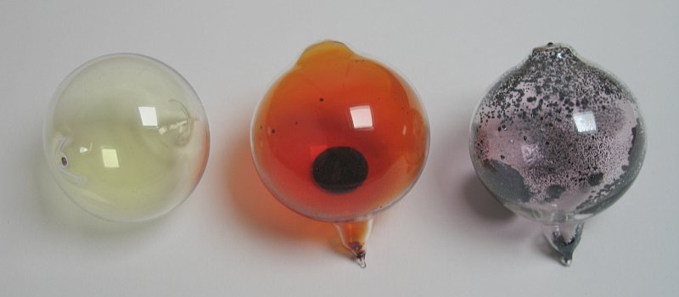
Halogens
Elements in Group 17 of the periodic table are called the halogens.
The halogens are the most reactive group of nonmetal elements.
•
When halogens react, they often gain the one electron needed to have eight valence electrons, a filled outer energy level.
•
Because the alkali metals have one valence electron, they are ideally suited to react with the halogens.
•
The halogens react with most metals to produce salts.

Slide 6
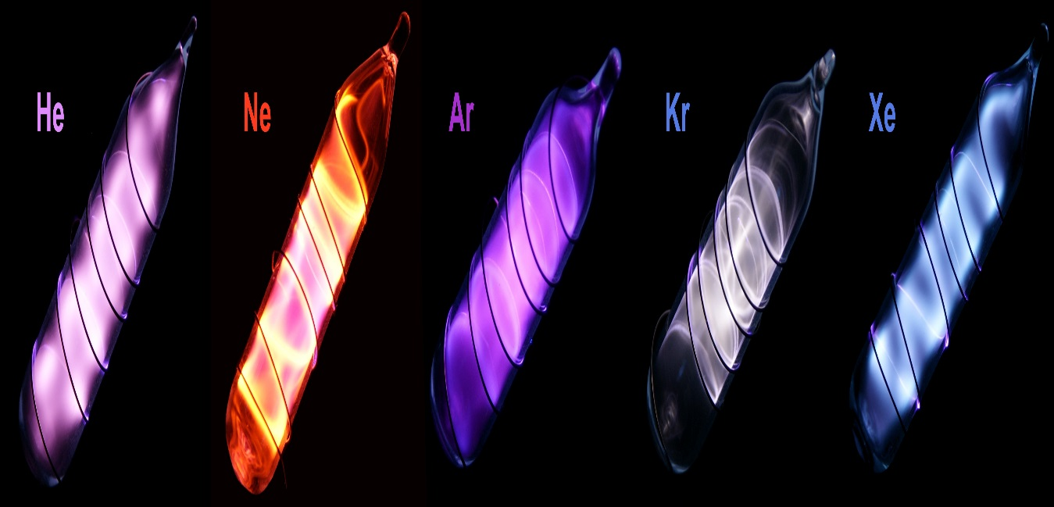
Noble Gases
Group 18 elements are called the noble gases.
•
The noble gas atoms have a full set of electrons in their outermost energy level.
•
The low reactivity of noble gases leads to some special uses.
•
The noble gases were once called inert gases because they were thought to be completely unreactive.
•
In 1962, chemists were able to get xenon to react, making the compound XePtF6.
•
In 1979, chemists were able to form the first xenon-carbon bonds.

Slide 7
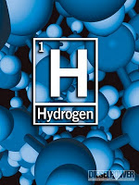
Hydrogen
Hydrogen is the most common element in the universe.
It is estimated that about three out of every four atoms in the universe are hydrogen.
• Because it consists of just one proton and one electron, hydrogen behaves unlike any other element.
• Hydrogen is in a class by itself in the periodic table.

Slide 8
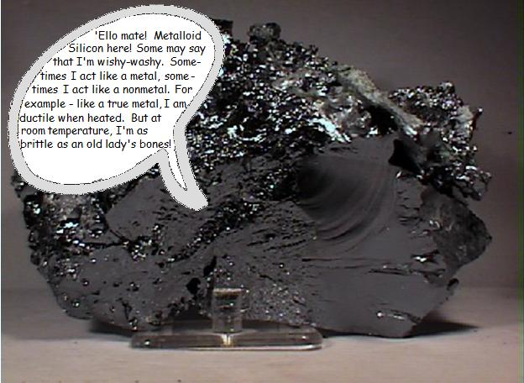
Metalloids
Metalloids are found on the periodic table between the metals and nonmetals.
• A metalloid is an element that has some characteristics of metals and some characteristics of nonmetals. All metalloids are solids at room temperature.
• Metalloids are less malleable than metals but not as brittle

Slide 9
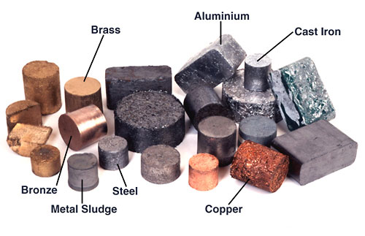
Metals
All metals are excellent conductors of electricity.
Electrical conductivity is the one property that distinguishes metals from the nonmetal elements.
• Some metals, such as manganese, are brittle.
• Other metals, such as gold and copper, are ductile and malleable.
Ductile means that the metal can be squeezed out into a wire.
Malleable means that the metal can be hammered or rolled into sheets.

Slide 10
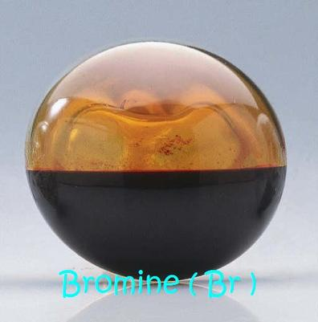
Nonmetals
Many nonmetals are gases at room temperature. (Bromine is a liquid at room temperature).
• Solid nonmetals include carbon, phosphorus, selenium, sulfur, and iodine. These solids are brittle at room temperature.
• A nonmetal is an element that is a poor conductor of heat and electricity.
• Nonmetals are found on the right hand side of the periodic table.

Slide 11
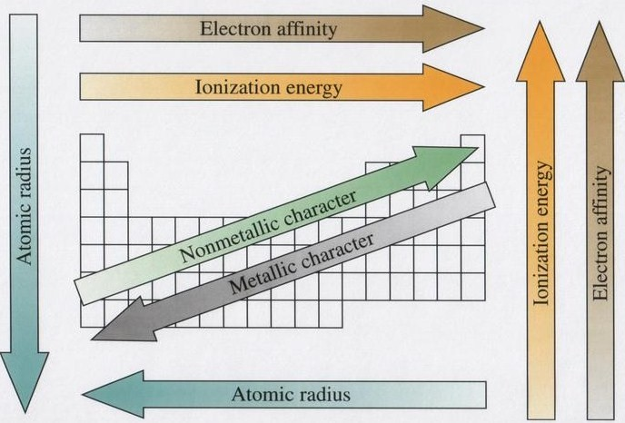
Other Periodic Trends
The arrangement of the periodic table reveals trends in the properties of the elements.
A trend is a predictable change in a particular direction.
Understanding a trend among the elements enables you to make predictions about the chemical behavior of the elements.
These trends in properties of the elements in a group or period can be explained in terms of electron configurations.
Atomic radius - distance from the center of an atom's nucleus to its outer most electron
First ionization energy - the amount of energy needed to remove one (the outermost) electron from an atom.
Electronegativity - the measure of an atoms attraction for electrons in a chemical bond

Slide 12
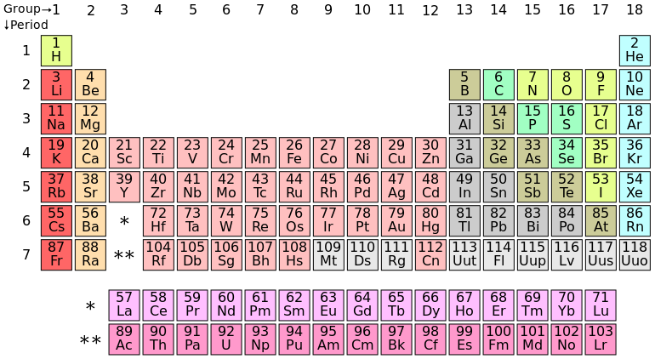
Periodic Table

Slide 13
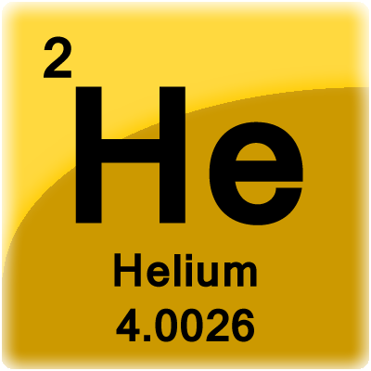
Periodic Table Tile

