Slide 1
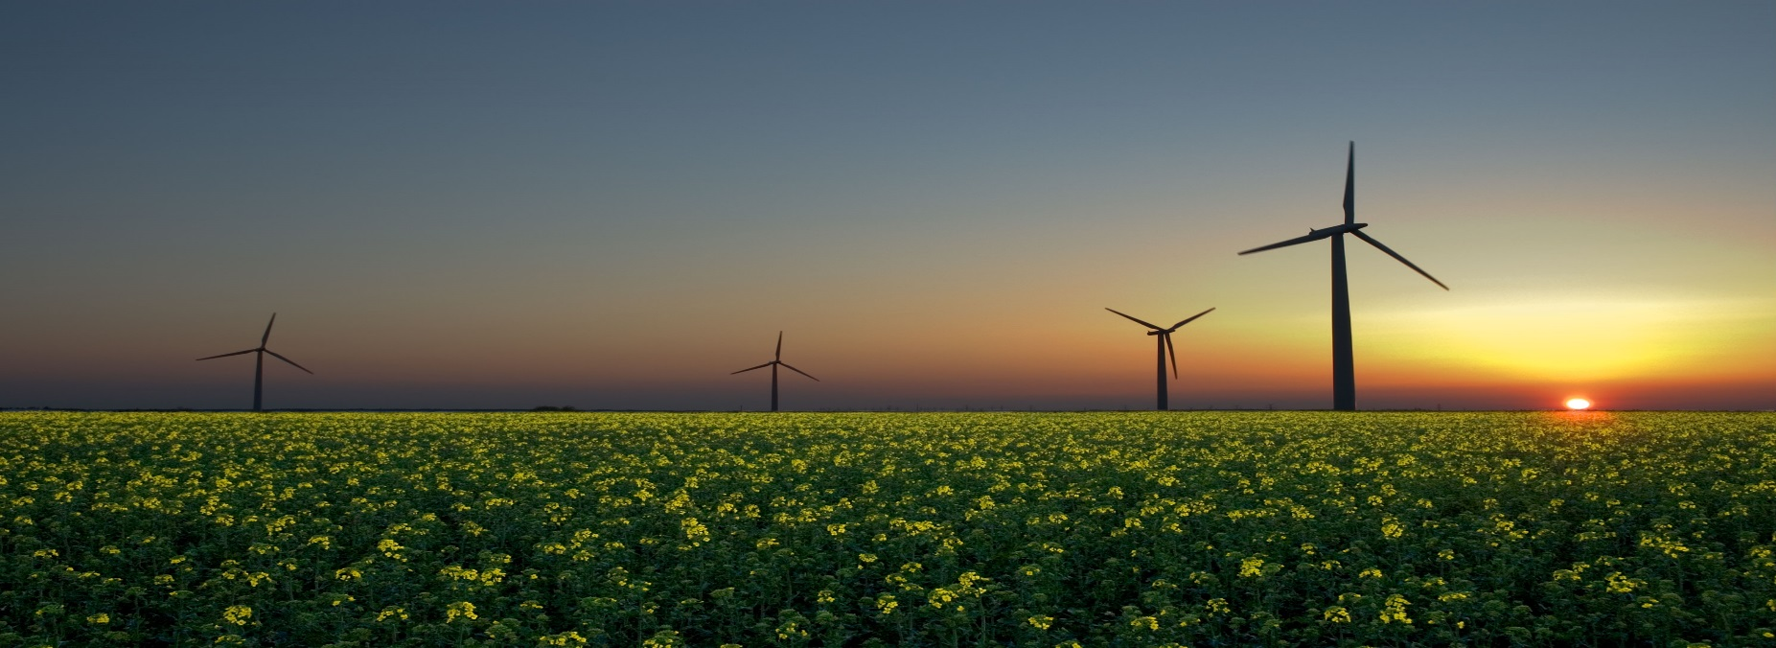
Chapter 6 Energy

Slide 2
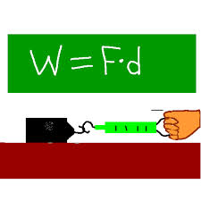
6.1 Work – Force x Distance
Amount of work done on an object depends on
How much force is applied
How far the force causes the object to move
Work is done when a net force acts on an object and the object moves in the direction of the net force

Slide 3
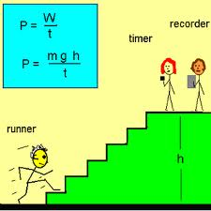
6.2 Power – How Quickly Work Gets Done
Lifting a load quickly is more difficult that lifting the same load slowly
Power is the rate at which energy is changed from one form to another
It equals the amount of work done divided by the time interval during which work is done

Slide 4
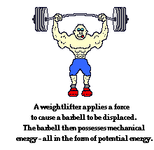
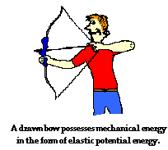
6.3 Mechanical Energy
The ability to do work is called energy
Energy is measured in Joules
Appears in many forms
Mechanical energy appears in the form of potential energy, kinetic energy or both

Slide 5
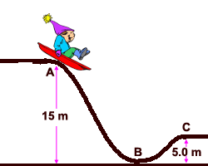
6.4 Potential Energy is Stored Energy
Energy stored due to position
Various kinds of PE:
Elastic
Chemical
gravitational
GPE:
Amount of GPE possessed by an elevated object is equal to the work done against gravity in lifting it

Slide 6
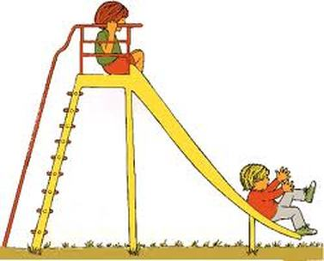
6.5 Kinetic Energy is Energy of Motion
When you push on an object you can make it move
KE is energy of motion
KE depends on:
Mass
speed
If a car moving along a road has a certain amount of KE, when it moves twice as fast it has four times as much KE

Slide 7
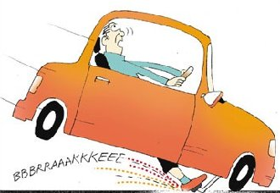
6.6 The Work Energy Theorem
To increase KE, work must be done on it
If an object is moving, work must be done to bring it to rest
Therefore, whenever work is done energy changes

Slide 8
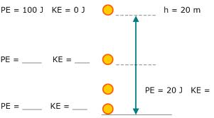
6.7 Conservation of Energy
Energy cannot be created or destroyed, it may be transformed from one form to another or transferred from one place to another, but the total energy stays the same.

Slide 9
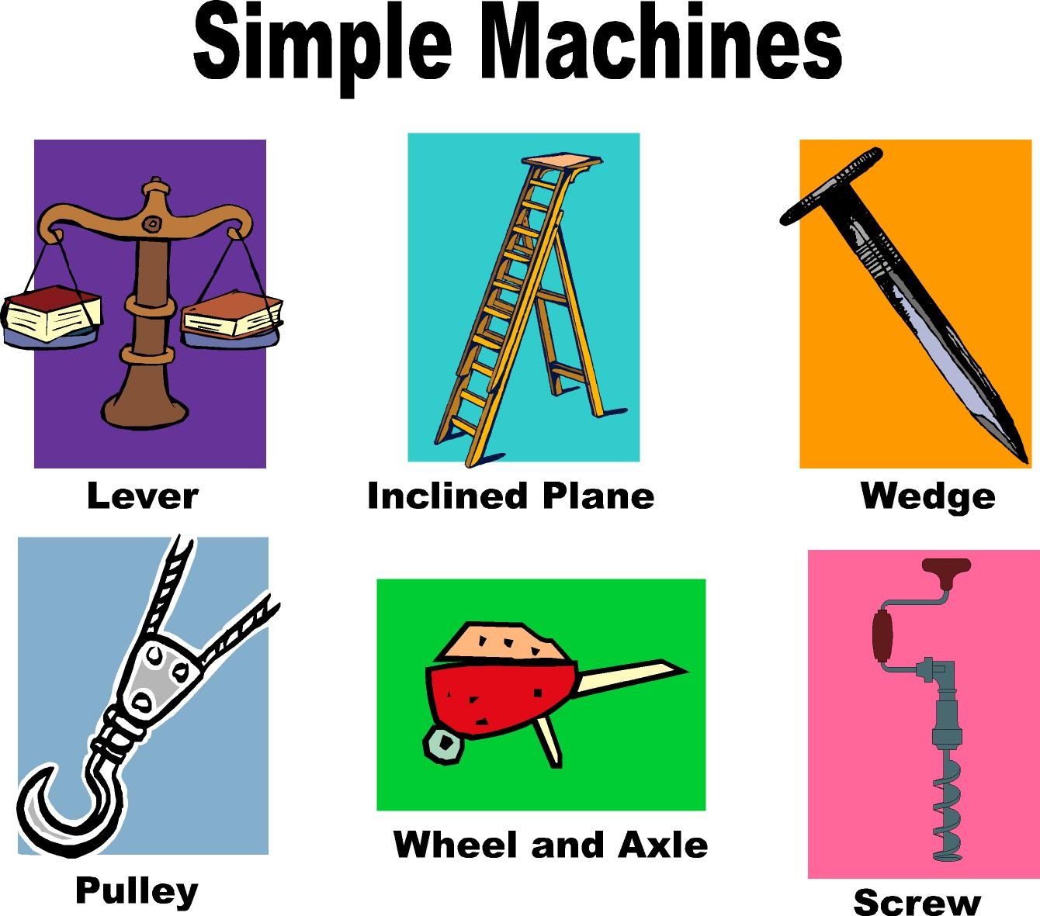
6.8 Machines – Devices to Multiply Forces
A machine is a device for multiplying forces or simply changing the direction of the force
A machine transfers energy from one place to another or transforms it from one form to another

Slide 10
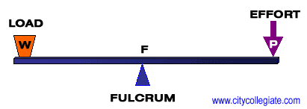
6.9 Efficiency – A Measure of Work Done for Energy Spent
Machines that can do more work are said to be more efficient
The lower the efficiency of a machine, the greater amount of energy wasted as heat.

Slide 11
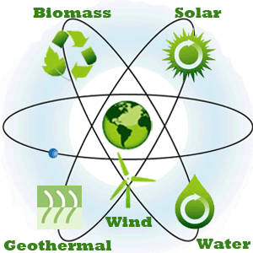
Alternative Sources of Energy
The total amount of energy in the universe is constant, so the world cannot run out.
However, useful energy delivered to humans is limited.
Fossil fuels
Renewable resources

Slide 12
Vocabulary
Biodiesel
Conservation of energy
Efficiency
Energy
Kinetic energy
Machine
Potential energy
Power
Renewable resource
Watt
Work
Work-energy theorem

