Slide 1
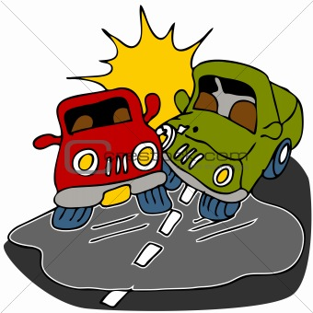
Newton’s third law of motion – action and reaction

Slide 2
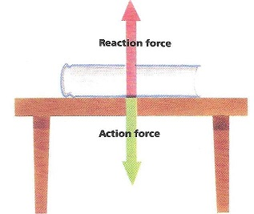
4.1 A force is a part of an interaction
A force is part of a mutual action – or interaction
The forces always occur in pairs – called a force pair
The forces are equal in strength and opposite in direction and they occur at the same time

Slide 3
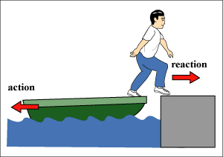
4.2 newton’s third law – action and reaction
Whenever one object exerts a force on a second object, the second object exerts an equal and opposite force on the first.
It does not matter which force we call the action or reaction. The important thing is that they are co-parts of a single interaction and that neither force exists without the other.

Slide 4
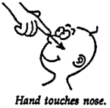
4.3 A simple rule helps identify action and reaction
If the action is A on B, the reaction is B on A.
Example:
Tire pushes on road, road pushes on tire.

Slide 5
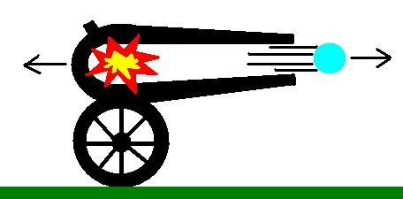
4.4 Action and reaction on objects of different masses
Remember the 2nd Law of Motion!
A given force exerted on a small mass produces a large acceleration, while the same force exerted on a large mass produces a small acceleration.

Slide 6
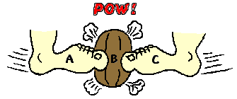
4.5 Action and reaction forces act on different objects
Why don’t action reaction pairs cancel to zero?
They act on different objects!
A system is a collection of objects that you are studying.

Slide 7
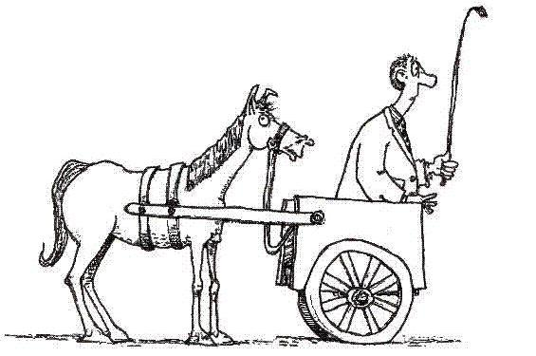
4.6 the classic horse – cart problem

Slide 8
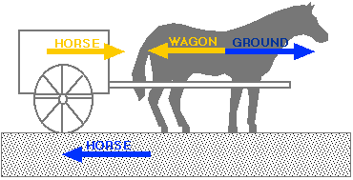
The answer

Slide 9
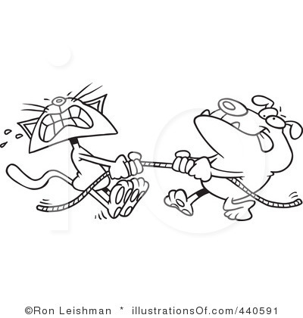
4.7 action equals reaction
Examples:
Tug of war
Helicopter
Bird flying
Animal locomotion

Slide 10
vocabulary
Force pair
Interaction
Newton’s third law
system

